Slide 1


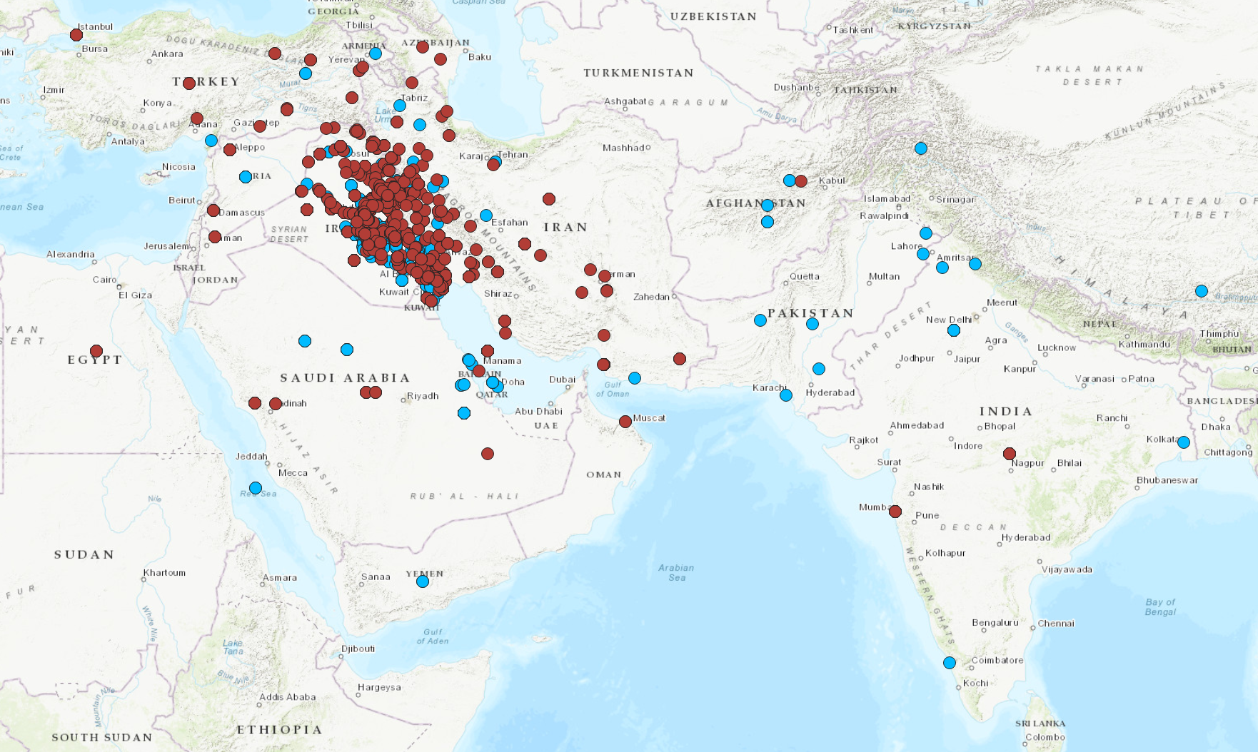
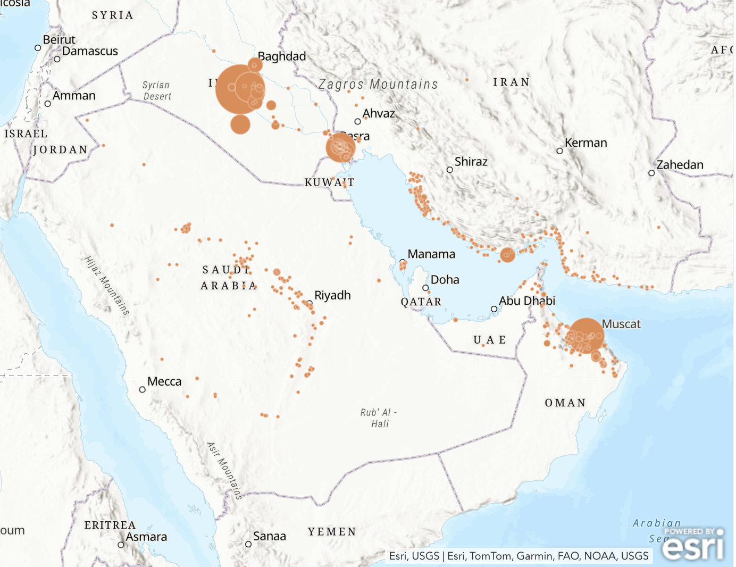
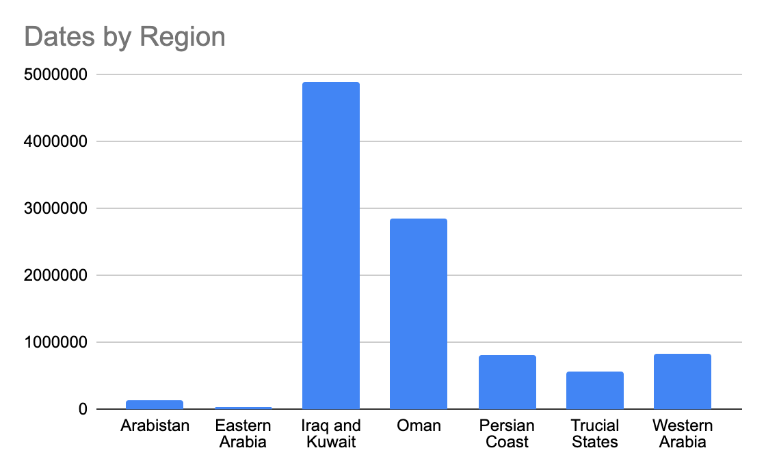
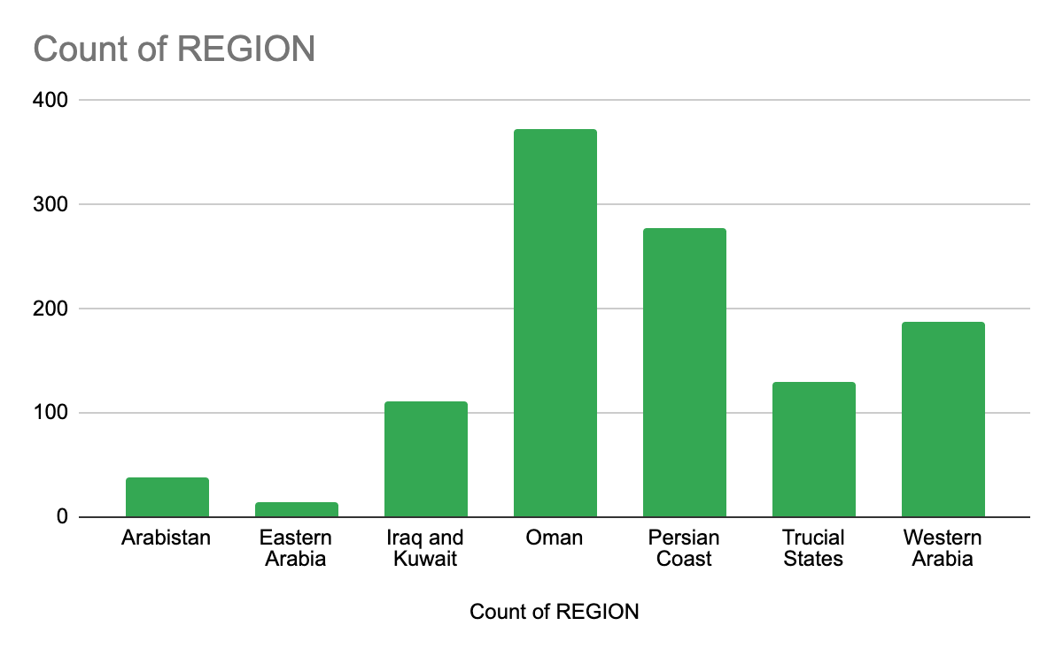
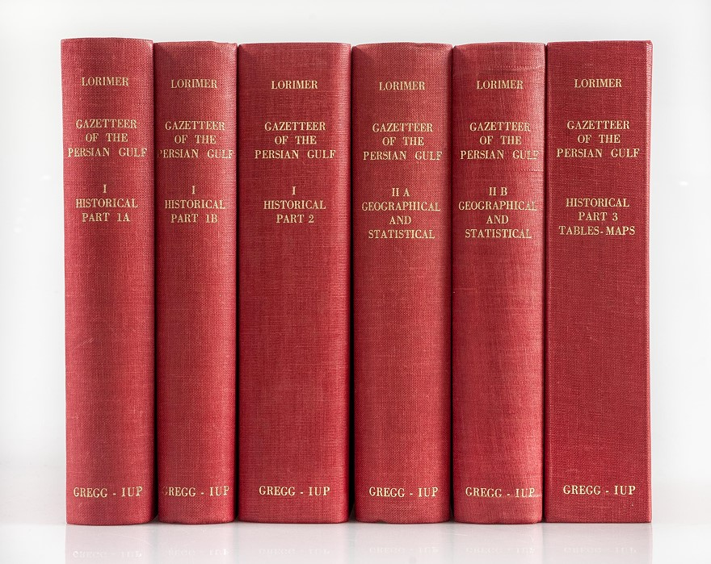
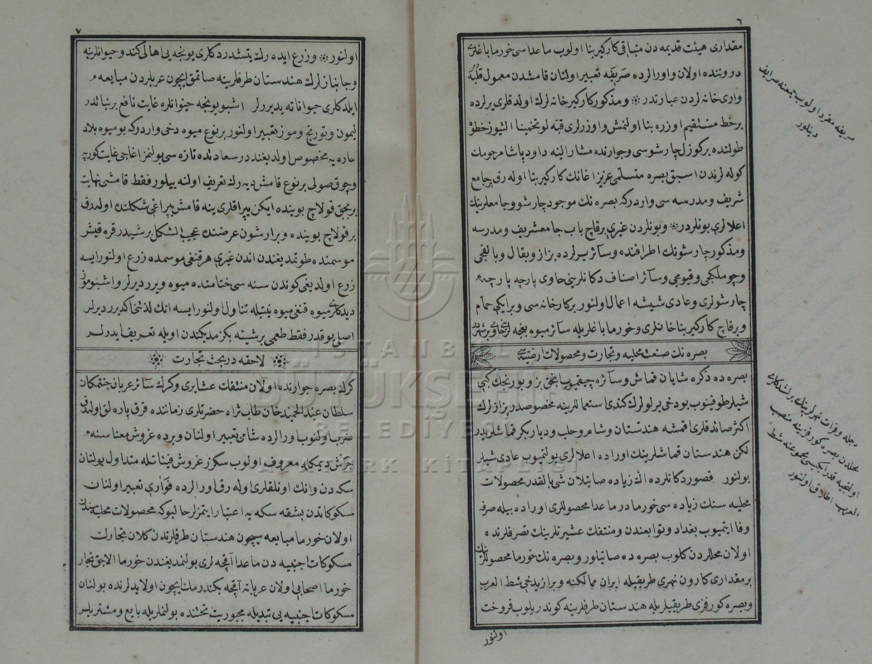




Mapping Gulf Spaces, Analyzing Imperial Texts: OpenGulf
Nora Barakat and Mustafa Emre Günaydı, Stanford University
Introduction: Historical Texts as Data
OpenGulf is a transdisciplinary, multi-institutional research group conducting multiple digital historical projects related to the Gulf region. Its Historical Texts Analysis project explores how different historical imperial formations imagined and constructed particular landscapes, human communities and commodities within the Gulf, broadly defined. Here we compare and connect the spatial extent and granularity of Ottoman and British knowledge production about Iraq. We also begin a project of mapping mentions of date palms, the most important commodity connecting the Gulf to the global economy in the early twentieth century, in historical texts.
Data Visualization
Conclusions
The Seyahatname provides a spatial visualization that intimately connects Iraq's geography with Western Iran, the Gulf, and the Arabian Peninsula.
Ottoman and British spatial imaginations of Southern Iraq, Western Iran, the Gulf and the Arabian Peninsula exhibits compatibility.
This map challenges the commonly accepted notion that the Ottoman Empire possessed minimal knowledge of Southern Iraq, Western Iran, and the Gulf during the 19th century.
The date palm map shows concentrations of large-scale plantation-based date production in Iraq and Oman and extensive small-scale production especially in Oman, the Persian Coast and Trucial States. The full dataset of mentions of date palms by region shown in the chart below, which are only partially geolocated and visualized in the work-in-progress map, amplifies these concentrations.
This map draws on two historical sources: Seyahatname-i Hudud and Lorimer’s Gazetteer. The Seyahatname was written by Mehmed Hurşid Pasha, a scribe in the Ottoman survey commission of 1848-1852. The commission aimed to resolve border disputes between the Ottoman and Qajar Empires. Most of the book’s information is based on Mehmed Hurşid’s observations and field notes during his trips along the Ottoman-Qajar border, which he published later under the title Seyahatname-i Hudud in 1861. The Gazetteer of the Persian Gulf, Oman, and Central Arabia, also known as Lorimer's Gazetteer, is a multi-volume encyclopedia compiled by John Gordon Lorimer. Originally published in 1908 by the British government in India, it served as a handbook for British diplomats and officials in the Arabian Peninsula, Iraq and Persia. Place names extracted from the Seyahatname are showed with red and from Lorimer with blue dots. The map depicts all the locations mentioned in the Baghdad and Basra chapters of the Seyahatname-i Hudud and the “Iraq” entry of the Gazetteer’s geographical dictionary.
Methodology
OpenGulf prioritizes team-based knowledge creation and collaboration among many stakeholders including undergraduates. We adopt minimal and sustainable infrastructure and workflows whenever possible. The Historical Texts Analysis project employs a three-step workflow:
Annotating prepared text files using Recogito to link mentioned entities to Geonames IDs
Disambiguating, cleaning and augmenting produced place name datasets using Antconc, Google Sheets, and OpenRefine
Mapping datasets-in-progress in ArcGIS Online as part of data cleaning
Mapping completed datasets with QGIS
QGIS map illustrating the place names referenced in the Iraq sections of Lorimer’s Gazetteer and the Seyahatname-i Hudud
Dates linked the Persian Gulf region to an expanding global capitalist economy at the turn of the twentieth century when the British imperial government commissioned Lorimer’s Gazetteer. Increasing date production for long-distance, steamship-powered trade entailed transformations of the form and scale of date farms in the Gulf. Scholars have documented an increase in the slave trade in sites of mass production like Oman’s Batinah coast and massive wealth accumulation among tax-farming and landowning Ottoman elites in southern Iraq, both closely related to date production.
This is a work-in-progress visualization of the counts of date palms in Lorimer’s Gazetteer. This map shows 53% of the 1134 locations identified as sites of date production, and 8,200,000 of the over 10 million date palms the Gazetteer documents.
Lorimer’s Gazetteer includes extensive, tabularly-expressed information about small-scale date production, especially in the Oman and Persian Coast regions. British data constructs a picture of expanding plantation-based large-scale production for the global economy alongside enduring small-scale production. It also shows concentrations of British knowledge of small-scale production in certain regions the Gazetteer covers, especially Oman and the Persian Coast.
Number of date palms (total over 10M) mentioned in Lorimer’s Gazetteer by region
John G. Lorimer, Gazetteer of the Persian Gulf, Oman and Central Arabia, 1908
Mehmed Hurşid Paşa, Seyahatname-i Hudud, 1861
Locations of date production mentioned in Lorimer’s Gazetteer (1134) disaggregated by region
In-progress ArcGIS Online map of Lorimer’s counts of date palms in the 1908 Gazetteer
Recogito
Antconc
OpenRefine
QGIS

